Slide 2
Course Description
This course presents the core principles and advanced techniques of deep learning, with a focus on computer vision applications.
You will learn to build, train, and deploy models for real-world tasks such as image classification, object detection, and segmentation.

Slide 3
Course Overview
1. Core Concepts of Deep Learning in computer vision:
CNNs, GANs, Vision Transformers
2. Practical Model Development:
Image Classification, Object Detection, Segmentation
3. Model Deployment:
Cloud Platforms, Edge Devices

Slide 4
Learning Outcomes
By the end of this course, you will be able to: - Demonstrate a comprehensive understanding of deep learning concepts - Develop and train deep learning models - Evaluate performance using appropriate metrics - Deploy models in real-world environments

Slide 5
Course Texts
Core Reading Materials for the Course
Aggarwal, C. (2023).Neural Networks and Deep Learning. Springer
Goodfellow, I., Bengio, Y., & Courville, A. (2017). Deep learning. MIT Press
Brownlee, J. (2019). Deep Learning for Computer Vision.
Recommended Reference Materials
Chollet, F. (2021). Deep Learning with Python. Manning Publications.
Géron, A. (2019). Hands-On Machine Learning with Scikit-Learn, Keras, and TensorFlow. O’Reilly.
Rosebrock, Adrian (2018). Deep Learning for Computer Vision with Python. Pyimagesearch.

Slide 6
Course Learning Materials
Required tools and resources: - Frameworks: TensorFlow, PyTorch
- Programming Language: Python - Hardware: GPU-enabled machine (recommended) - Tools:
Jupyter Notebooks,
Google Colab, Kaggle Kernels
Cloud Platforms

Slide 7
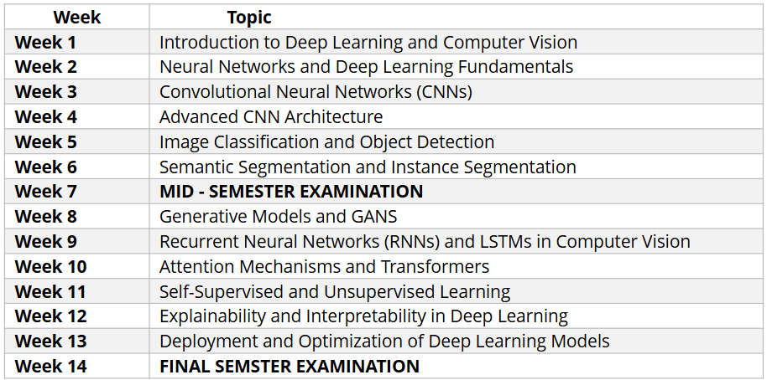
Course Syllabus

Slide 8
What to Expect
Learning Mode: - Hands-on coding exercises - Practical projects - Quizzes and assessments - Discussions and Q&A sessions

Slide 9
Course Assessment
Class Attendance and Participation 10% Assignments and Labs 25% Term Project 15% Mid-Semester Examination 20% Final Examination 30% Total 100%

Slide 10
Week 1
Introduction to Deep Learning for Computer Vision

Slide 11
Week 1 Learning Outcomes
Explain the fundamental concepts of deep learning
Discuss historical milestones and key developments in the evolution of computer vision and deep learning.
Install and set up basic deep learning frameworks on local machines.

Slide 12
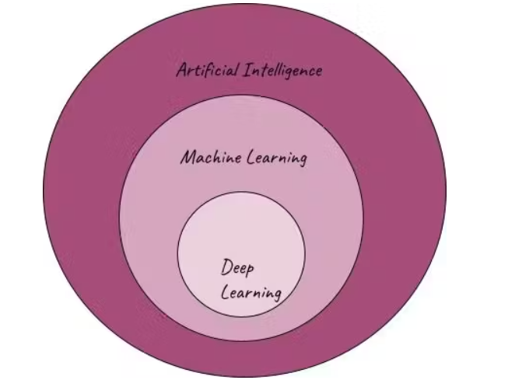
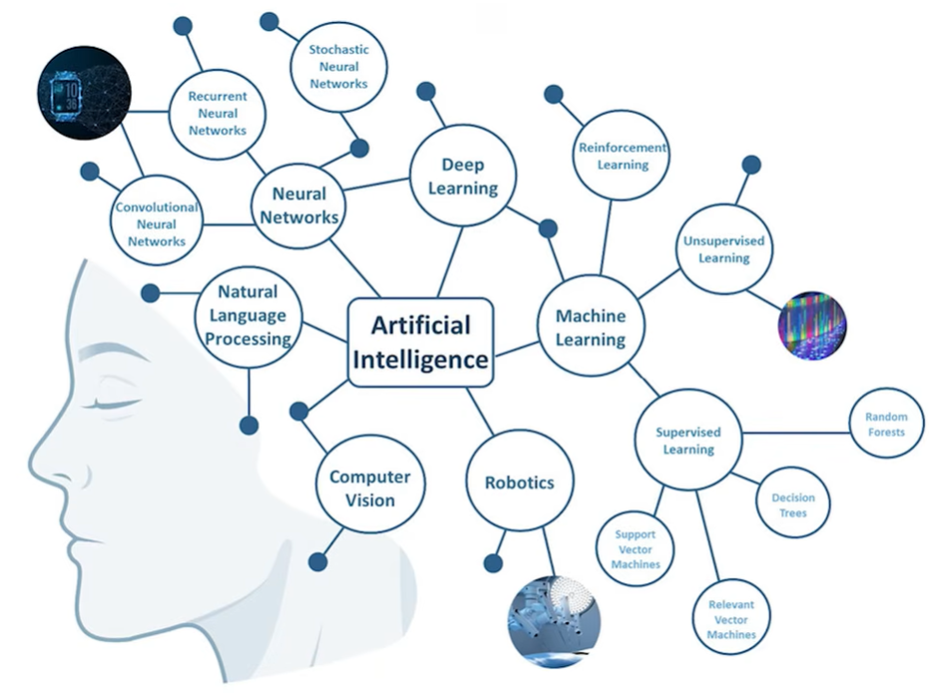
https://www.youtube.com/watch?v=PflqcFYwQOE
https://www.youtube.com/watch?v=zKVXNVnPCrQ

Slide 13
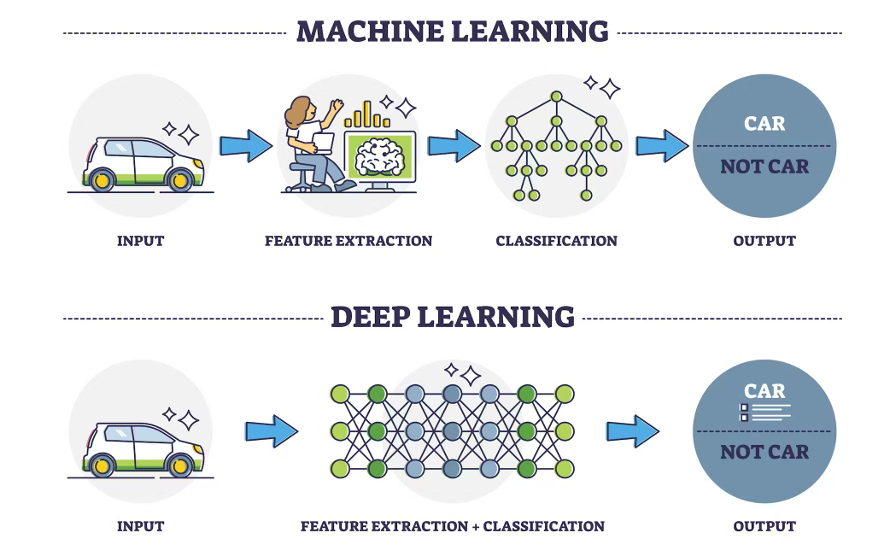
Notes:
Machine learning uses statistical learning algorithms to find patterns in available data and perform predictions and classifications on new data. ML also comprises both supervised and unsupervised learning.
Deep learning relies on multi-layered neural network models to perform complex tasks. There is a significant difference in the capabilities and applications of both. Understanding them is essential to knowing which to use in projects and get the best results.
Deep learning models are best used on large volumes of data, while machine learning algorithms are generally used for smaller datasets. In fact, using complex DL models on small, simple datasets culminate in inaccurate results and high variance - a mistake often made by beginners in the field.
DL algorithms are capable of learning from unlabeled or unstructured data, whereas ML models generally learn to process structured data.

Slide 14
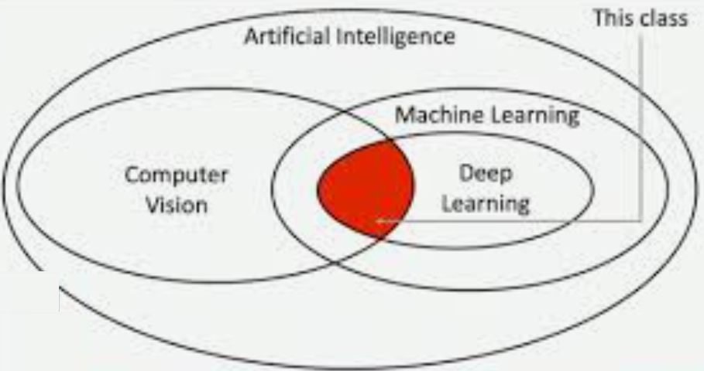
Deep learning for computer vision, a domain within artificial intelligence and machine learning, concentrates on employing deep neural networks for tasks centered on visual perception.

Slide 15
What is Deep Learning?
DL is a subset of machine learning that deals with neural networks, particularly those with many layers.
DL enables machines to learn from data that are unstructured and unlabeled, such as images, video, and text.
The key concept behind deep learning is that it allows models to automatically discover representations from data, particularly complex data like images or text, making it highly versatile for a variety of applications

Slide 16
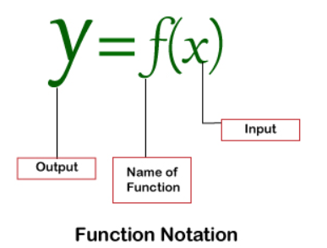
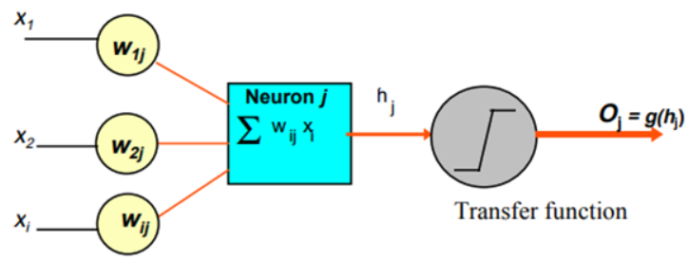
What is Artificial Neural Network?
(ANN) is a mathematical model that tries to simulate the structure and functionalities of biological neural networks
Historical background and evolution of ANN.
Importance and applications of ANN.
Notes:
An Artificial Neural Network (ANN) is a mathematical model that tries to simulate the structure and functionalities of biological neural networks.
Basic building block of every artificial neural network is artificial neuron, that is, a simple mathematical model (function).
A neuron takes inputs, does some math with them, and produces one output.
Such a model has three simple sets of rules: multiplication, summation and activation.
At the entrance of artificial neuron the inputs are weighted what means that every input value is multiplied with individual weight. In the middle section of artificial neuron is sum function that sums all weighted inputs and bias. At the exit of artificial neuron the sum of previously weighted inputs and bias is passing through activation function that is also called transfer function.
Weights, as the name suggests, are used to attach some weightage to a certain feature. Some features might be more important than other features to get the desired output.

Slide 17
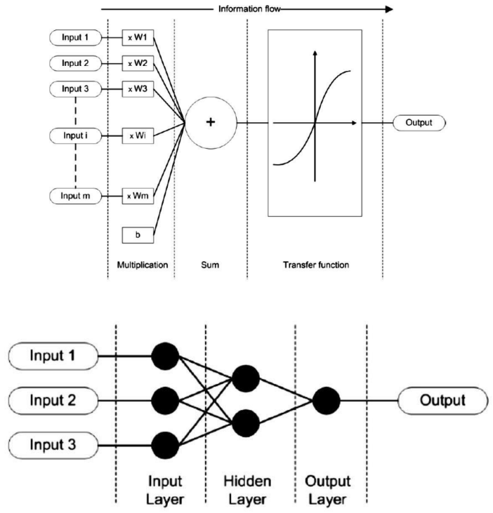
ANN
D
Notes:
3 things are happening here. First, each input is multiplied by a weight:
Next, all the weighted inputs are added together with a bias b:
Finally, the sum is passed through an activation function:
The activation function is used to turn an unbounded input into an output that has a nice, predictable form. A commonly used activation function is the sigmoid function:

Slide 18
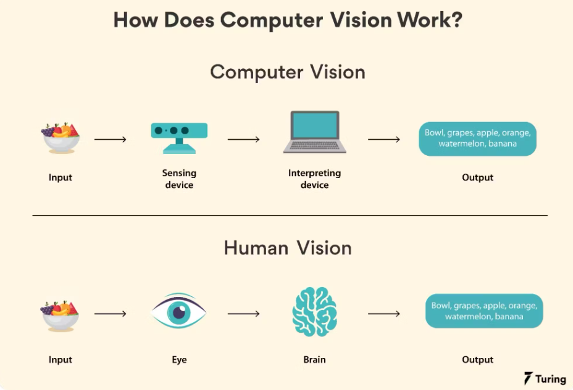
Notes:
Computer vision is the ability of computers to recognize and extract data/information from objects in images, videos, and real-life events.
Unlike humans, computers have a hard time processing visual data. While we can interpret what we perceive depending on our memories and prior experiences, computers cannot. To bridge the gap between what they see and understand, computers employ artificial intelligence (AI), neural networks, deep learning (DL), parallel computing, and machine learning (ML).
Instead of looking at an entire image like we do, a computer divides it into pixels and uses the RGB values ​​of each pixel to understand if the image contains important features. Computer vision algorithms focus on one pixel blob at a time and use a kernel or filter that contains pixel multiplication values ​​for edge detection of objects. The computer recognizes and distinguishes the image by observing all aspects of it including colors, shadows, and line drawings.
Today, we use convolutional neural networks (CNNs) for modeling and training. CNNs are special neural networks, specifically designed for processing pixel data, used for image recognition and processing. The convolutional layer contains multiple neurons and tensors. These process large datasets by learning to adjust their values ​​to match characteristics that are important for distinguishing different classes. This is done by extensively training the model.
One way to help computers learn pattern recognition is to feed them numerous labeled images so that they can look for patterns in all the elements.
For example, if you feed a million pictures of a ‘lion’ to a computer, they will go through algorithms that analyze the color, shape, distance between shapes, boundaries between objects, etc., so that they become profiles. The computer can then use the experience when fed other unlabeled images to know whether an image shown is that of a lion.

Slide 19
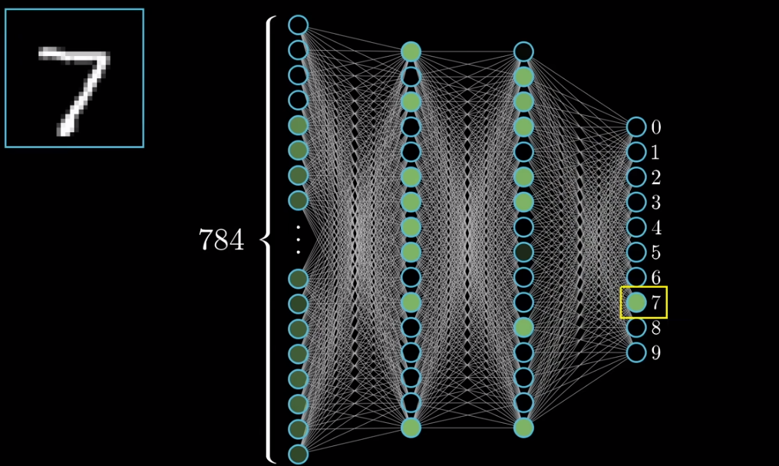
Notes:
Image Recognition

Slide 20
Case:
https://www.youtube.com/watch?v=aircAruvnKk

Slide 21
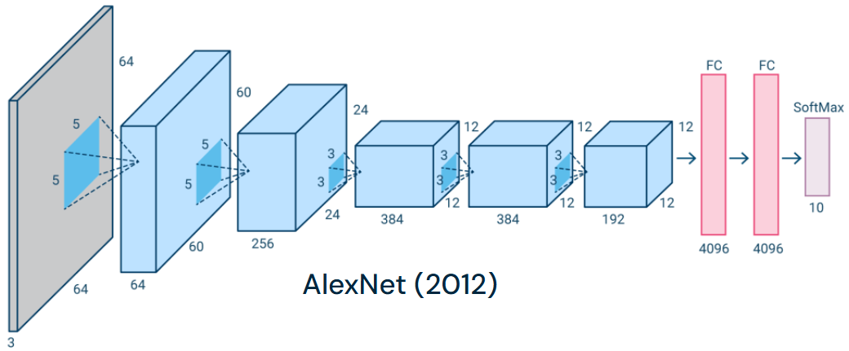
DL Architectures for Computer Vision
Notes:
The performance and efficiency of a CNN is determined by its architecture. This includes the structure of layers, how elements are designed, and which elements are present in each layer. Many CNNs have been created, but the following are some of the most effective designs.
AlexNet is an architecture based on the earlier LeNet architecture. It includes five convolutional layers and three fully connected layers. AlexNet uses a dual pipeline structure to accommodate the use of two GPUs during training.
GoogleNet, also known as Inception V1, is based on the LeNet architecture. It is made up of 22 layers made up of small groups of convolutions, called “inception modules”. These inception modules use batch normalization and RMSprop to reduce the number of parameters GoogleNet needs to process. RMSprop is an algorithm that uses adaptive learning rate methods.

Slide 22
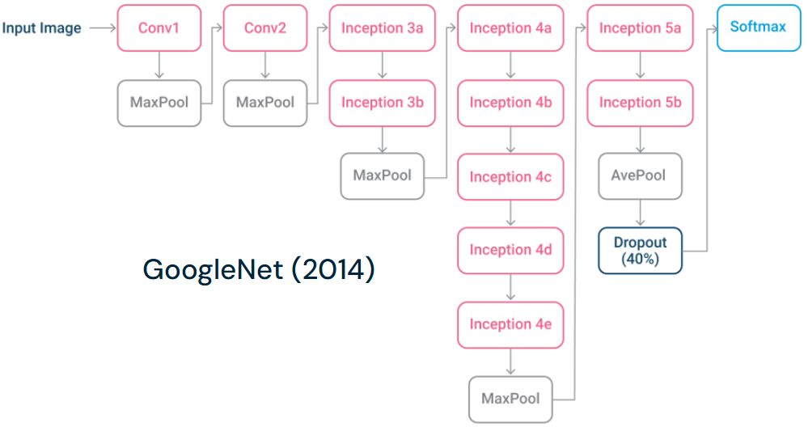

Slide 23
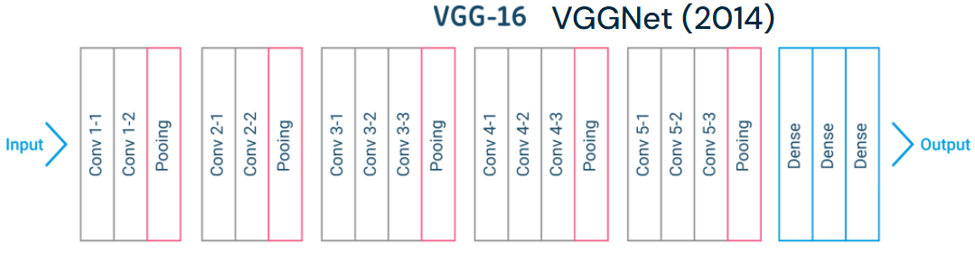
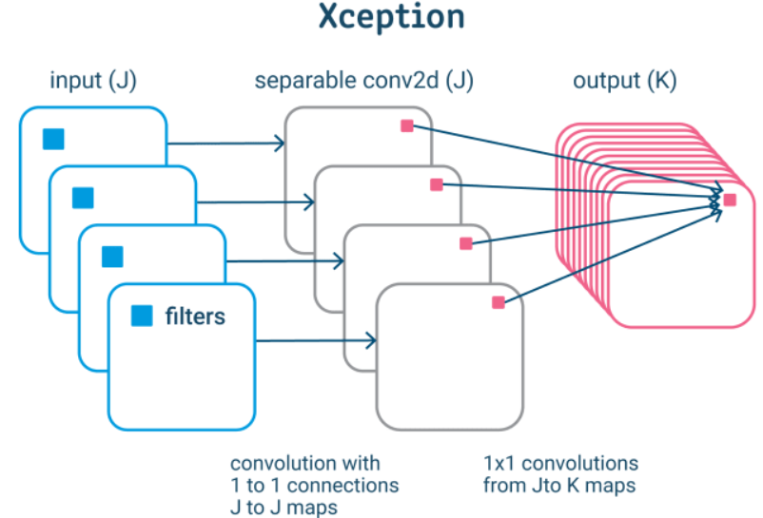
2016
Notes:
VGG 16 is a 16 layer architecture (some variants had 19 layers). VGGNet has convolutional layers, a pooling layer, a few more convolutional layers, a pooling layer, several more conv layers and so on.
VGG is based on the notion of a much deeper network with smaller filters – it uses 3×3 convolutions all the way, which is the smallest conv filter size that only looks at some of the neighbouring pixels. It uses small filters because of fewer parameters, making it possible to add more layers. It has the same effective receptive field as if you have one 7×7 convolutional layer.
Xception is an architecture based on Inception, that replaces the inception modules with depthwise separable convolutions (depthwise convolution followed by pointwise convolutions). It works by first capturing cross-feature map correlations and then spatial correlations. This enables more efficient use of model parameters.

Slide 24
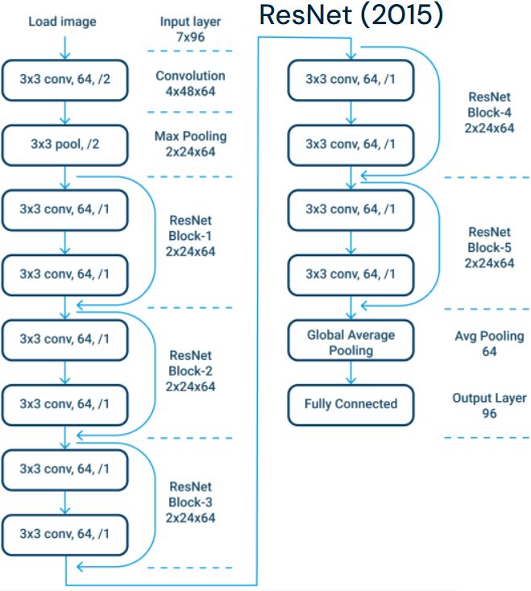
Notes:
ResNet, short for Residual Neural Network, is an architecture designed to have a large number of layers – typically used architectures range from ResNet-18 (with 18 layers) to ResNet-1202 (with 1202 layers).These layers are set up with gated units or “skip connections” which enable it to pass information to later convolutional layers. ResNet also employs batch normalization to improve the stability of the network.

Slide 25
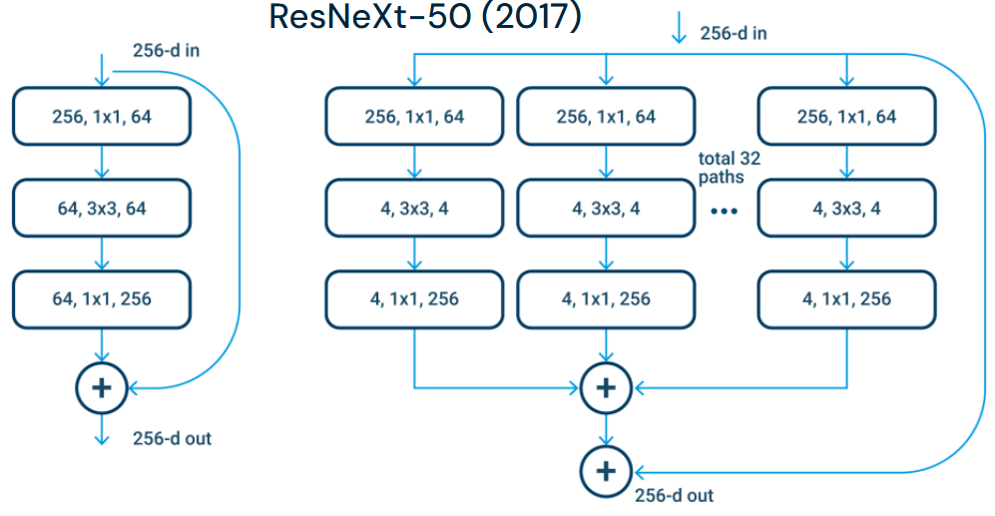
Notes:
ResNeXt-50 is an architecture based on modules with 32 parallel paths. It uses cardinality to decrease validation errors and represents a simplification of the inception modules used in other architectures.

Slide 26
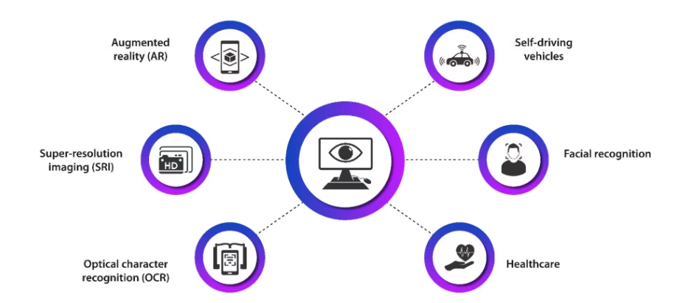
Applications
Notes:
Facial recognition
As discussed, computer vision is extensively used in facial recognition systems, thanks to its ability to find patterns in elements in the data. It then makes recommendations or takes action based on the data.
Self-driving vehicles
Computer vision enables autonomous vehicles to gain a sense of their surroundings by creating 3D maps out of real-time images. Cameras capture video from different angles around a car and feed it to computer vision software. It processes it to identify the extremities of roads, browse traffic signs, and discover alternative cars, objects, and pedestrians. The car can then steer its approach on streets and highways, avoid obstacles, and drive its passengers to their destination.
Healthcare
Computer vision has been used in a variety of healthcare applications to help healthcare professionals make better decisions related to patient care. Medical imaging or medical imaging analysis is one such procedure. It creates visualizations of specific organs or tissues to enable a more accurate diagnosis.
Augmented reality (AR)
Computer vision is implemented in augmented reality to extend imagery and sound to real-world environments. It detects real-life objects through the lens of, say, a smartphone, and performs computational operations. Among other things, we can use AR to measure the height of a table merely by using a smartphone’s camera.
Super-resolution imaging (SR)
SR is a technique that enhances the resolution of images. It is achieved with the help of four methods or algorithms: enhanced deep super-resolution network (EDSR), efficient sub-pixel convolutional neural network (ESPCNN), fast super-resolution convolutional neural network (FSRCNN), and Laplacian pyramid super-resolution network (LapSRN). These pre-trained models can easily be downloaded and used.
In super-resolution imaging, the model interprets numerous low-quality images differently, leading to the treatment of all the images as having unique information. Once the variations between the photographs are analyzed, the model produces a stream of images of significantly higher quality.
Optical character recognition (OCR)
OCR extracts text from images, scanned documents, and image-only PDFs. It identifies letters and puts them into words and sentences. The text is read using various contouring and thresholding techniques. Libraries like OpenCV are commonly used.
OCR technology is widely used to digitize text, scan passports for automatic check-in, evaluate customer data, etc.

Slide 27
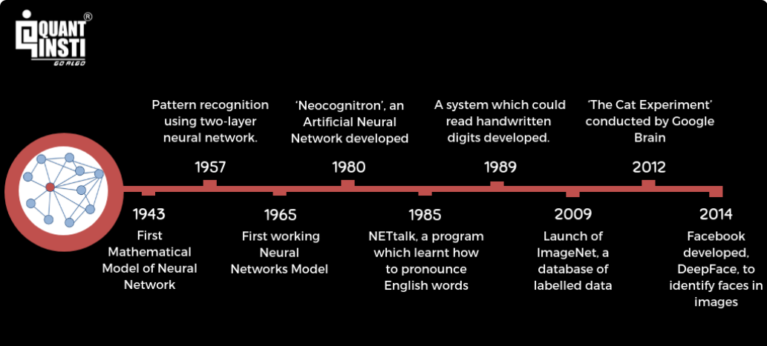
Historical Development of ANN

Slide 28
Further Reading
Deep Learning for Computer Vision – GeeksforGeeks
https://www.turing.com/kb/all-you-need-to-know-about-computer-vision
https://www.run.ai/guides/deep-learning-for-computer-vision

